Slide 1
Name, Image, & Likeness
(NIL)

Slide 2
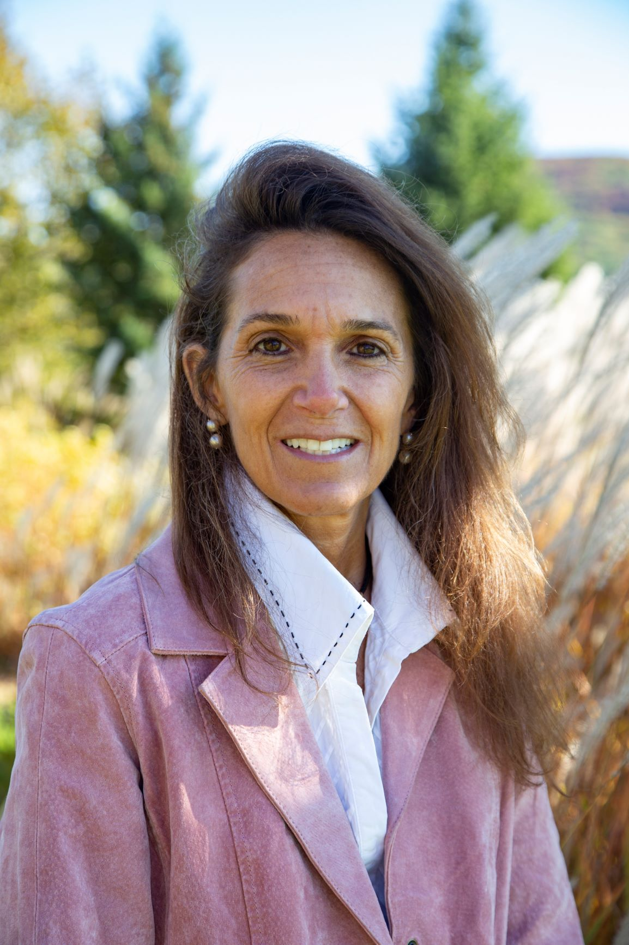
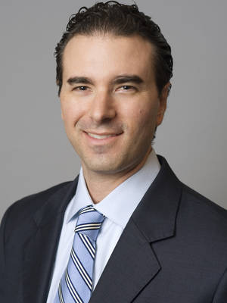
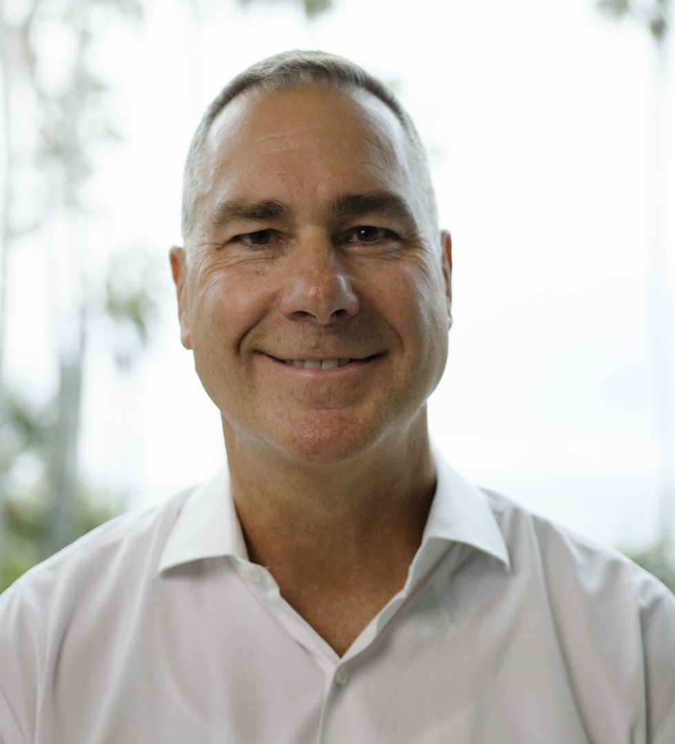
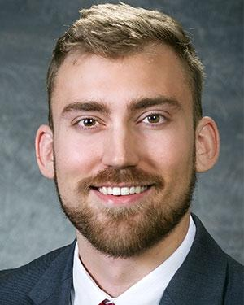
Speakers
  Ellen M. Zavian, Esq., USA Lacrosse General Counsel and Professor of Sports Law and NIL at George Washington University
  Brad Shear, Esq., Founder, Digital Armour LLC
  Mark Koesterer, Founder of The Players NIL
  Grayson Wagner, Director of NIL Services at Univ. Of Maryland

Slide 3

NIL For All
The median NIL deal in Year 1 was $65
6 of the top 10 NIL sports are women’s sports
The king of NIL, Rayquan Smith, is a HBCU student
With just 1,000 followers you can create value
Brands are looking for influencers

Slide 4
Why Should I Start Now?
There is an NIL deal for everyone from $100 to $1,000
Only 2% of college athletes will have on-campus support
Creating self worth away from athletics is good for mental health
As athletes we should give back to our communities
Building a brand takes time, start in High School
Creating life skills will pay dividends for years to come

Slide 5
What is NIL Education?
Digital Marketing
Influencer and Brand Relationship
Tax, Legal, and Compliance
Community Service and Philanthropy
Financial Literacy

Slide 6
Thank You

